Slide 1

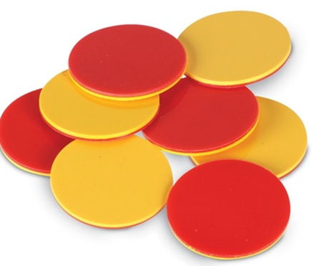
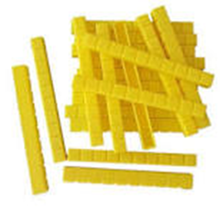
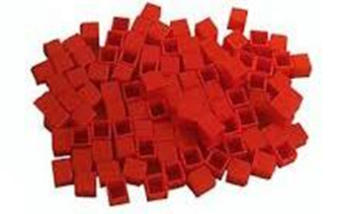
Parent Workshop
Monday 4th March
9 am in the hall
3.30pm in 2J
Maths in Key Stage 1

Slide 2
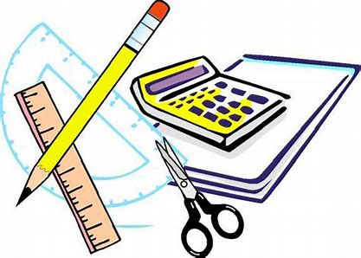
Maths in Key Stage 1

Slide 3
What we will cover:
Maths curriculum
Resources we use
Methods used at Abbey
Questions and how to work them out
How to help at home

Slide 4



Before we begin….
What is your experience of Maths from childhood?
Share and discuss
Notes:
Importance of showing that a problem is only a problem if they cannot solve it, to persevere, to have self-belief and the determination to succeed in solving the problems in order to be the best mathematicians that they can be.

Slide 5
How can you help your child with Maths at home?
Take away their fear.
Reassure and praise whenever possible. Positive mindset…
Let them see you using Maths in your everyday routines – portioning meals between the family, chopping vegetables into halves and quarters etc.
Play with numbers and shapes through games.
Seeing mistakes as an opportunity to learn and using them as a discussion point.
Recognising the importance and value of maths in our everyday lives e.g. managing money and telling the time.

Slide 6
Curriculum expectations
The national curriculum for mathematics aims to ensure that all pupils:
become fluent in mathematics
develop conceptual understanding and the ability to recall and apply knowledge rapidly and accurately
reason mathematically by following a line of enquiry, conjecturing relationships and generalisations, and developing an argument, justification or proof using mathematical language
can solve problems by applying their mathematics to a variety or routine and non-routine problems with increasing sophistication, including breaking down problems into a series of simpler steps and persevering in seeking solutions
Notes:
Fluency – use key words from the NC -–is more than chn being able to recall facts quickly but instead, it is about chn having a deep, flexible and adaptable understanding of Maths concepts. To promote fluency, Lessons and resources need to be crafted carefully to foster deep conceptual and procedural knowledge. .
If children are not fluent in basic facts, then when they are solving more complex problems, the working memory is taken up by calculating basic facts, and children have less working memory to focus on solving the actual problem So fluency in basic facts allows children to tackle more complex maths more effectively.
Children need to be taught strategies to solve number facts. most children don’t magically become fluent in these facts. If they aren’t explicitly taught to solve e.g. 6 + 7 by thinking ‘double 6 and one more’ or to solve 12 – 8 by using 'find the difference' strategies, then many children will get stuck on inefficient counting based approaches
Reasoning enables chn to make use of all their other mathematical skills when faced with a mathematical challenge. – discuss nrich – reasoning is systematic thinking
A conjecture is a mathematical statement that has not yet been rigorously proved. Conjectures arise when one notices a pattern that holds true for many cases.
Non routine problems are problems that are out of context where chn can apply their learning securely in a range of different contexts

Slide 7
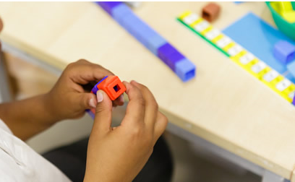
Skills in Maths and across the curriculum
Use Mathematical vocabulary
Explain ideas and evaluate outcomes
Make connections
Use fluency and recall
Predict and Justify
challenge ideas
Work systematically
Trial and improvement
Logical thinking
Be independent
Learn from mistakes
Collaborate with others
Spot patterns
Show resilience
Correct mistakes
Notes:
At Abbey we would like all chn to develop these skills

Slide 8
Fluency
Fluency in maths is about developing number sense and being able to choose the most appropriate method for the task at hand; to be able to apply a skill to multiple contexts.
The National Curriculum states that pupils should become fluent in the fundamentals of mathematics through varied and frequent practice.
We work on fluency everyday.
Year 1 work on this throughout the day- songs Jack Hartman
Year 2 every morning

Slide 9

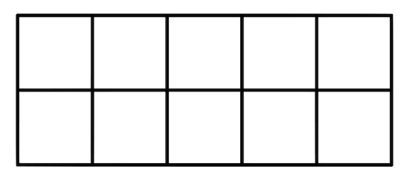
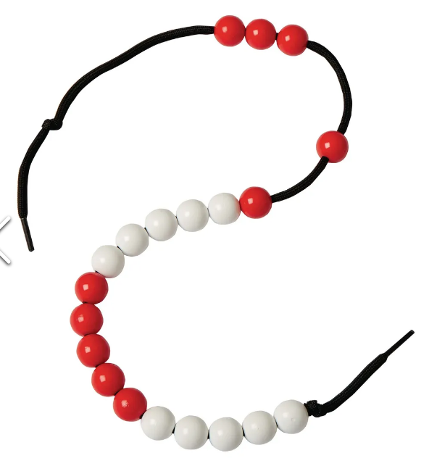
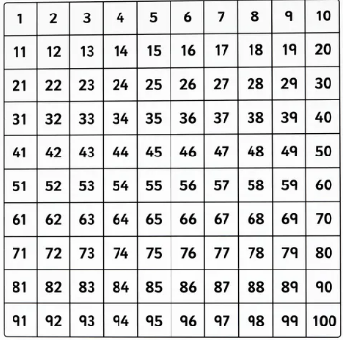
Resources we use at this school…

Slide 10


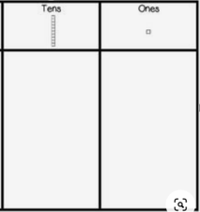
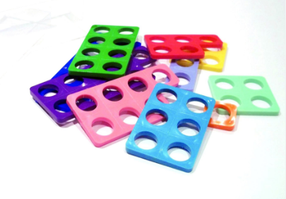
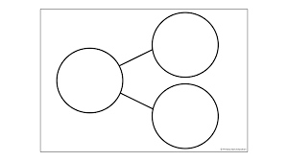

Slide 11
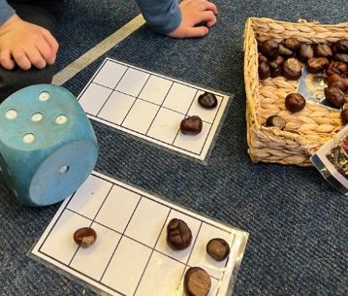
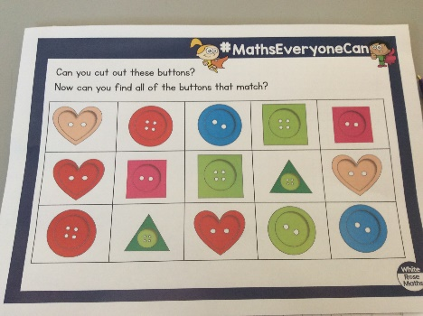
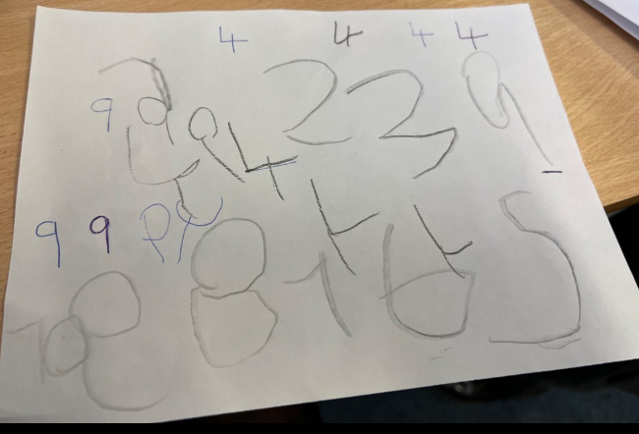
What does Maths looks like in EYFS?
Learning through play.
Outdoor activities.
Counting, counting and more counting!
Pattern spotting
Number recognition and ordering to 10.
Learning numbers bond up to 10.
Shape recognition, 2D and 3D.
Addition and subtraction using single digit numbers.

Slide 12
What does Maths look like in Year 1?
Number bonds to 10 and within 10.
Compose numbers to 10 from 2 parts, and partition numbers to 10 into parts, including recognising odd and even numbers.
To read time to O'clock and Half Past.
To double numbers to 10.
Count forwards and backwards in multiples of 2, 5 and 10.
Read, write and interpret equations containing +, - and = symbols.
Recognise common 2D and 3D shapes
Count within 100, forwards and backwards, starting with any number.

Slide 13
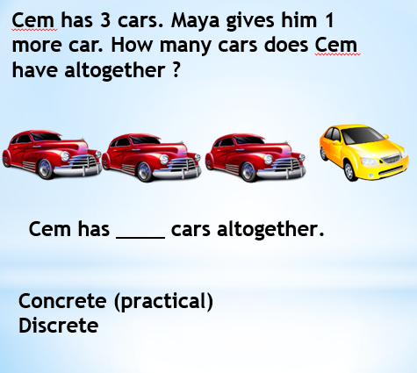
Concrete, pictorial, abstract approach
Have a go at using the concrete objects on the table to illustrate the problem in groups
Now draw it using pictorial representations
Individual squares, joined squares and then rectangular bars
Finally, how would this be recorded as a written method?
Build it … Draw it… Write it…..Say it.

Slide 14


Cem has 3 cars. Maya gives him 1 more car. How many cars does Cem have altogether ?
Cem has ____ cars altogether.
Concrete (practical)
– part - whole

Slide 15

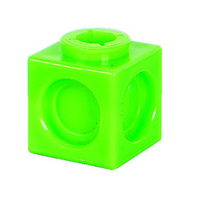
Cem has 3 cars. Maya gives him 1 more car. How many cars does Cem have altogether ?
Cem has ____ cars altogether.
Generic concrete practical)

Slide 16
Cem has 3 cars. Maya gives him 1 more car. How many cars does Cem have altogether ?
4
3 | 1
3 + 1 = 4
1
Cem has ____ cars altogether.

Slide 17
Using the CPA approach
How could we apply the CPA method to this problem?
Jon has 10 marbles. Harry gives Jon 12 more marbles. How many marbles does Jon have now?
Jon has ___ marbles.

Slide 18




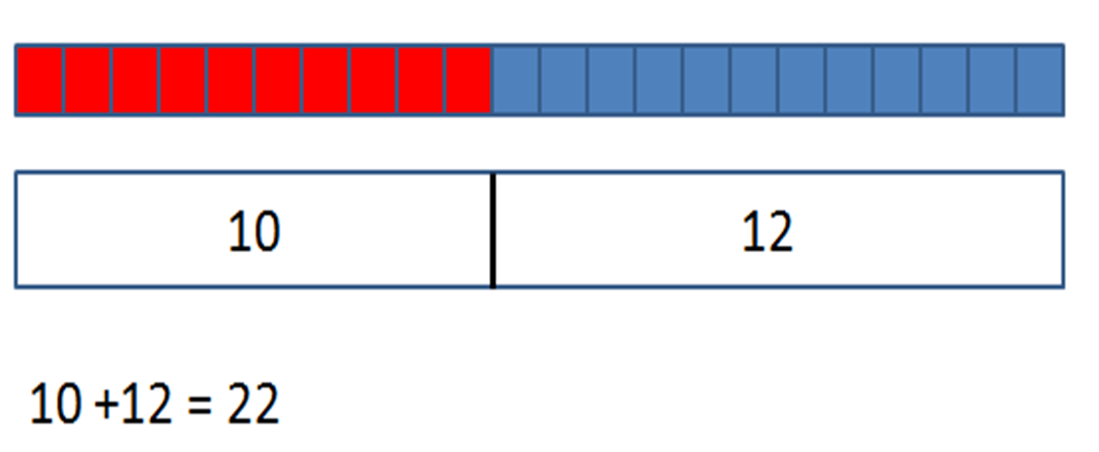
Concrete to pictorial to abstract
Jon has ____ marbles altogether.

Slide 19




Subtraction
Mrs Phillips has 6 cakes. She eats 2.
How many does she have left?
6-2=4

Slide 20
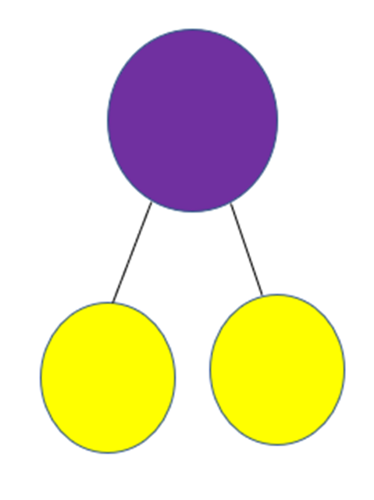
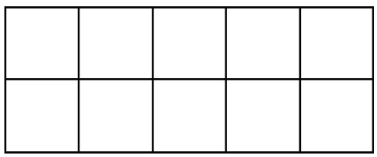

Subtraction with partitioning
Tim has 15 strawberries. He eats 7 . How many does he have left?
7
5
2
15 – 5 = 10
10 – 2 = 8
So
15 – 7 = 8
Number lines

Slide 21
What does Maths look like in Year 2?
Add and subtract within 100 by applying one-digit addition and subtraction facts. To add and subtract any 2 two-digit numbers.
Practical learning using a variety of resources.
To read the time to the nearest five minutes
To describe the properties of 2D and 3D shapes and compare shapes by their properties
Recognise the place value of each digit in two-digit numbers.
Secure fluency in addition and subtraction facts within 10.
Recognise the subtraction structure of ‘difference’ and answer questions such as “How many more…?”.

Slide 22
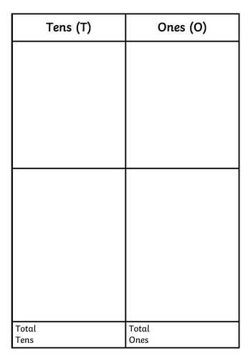



In 2J there are 13 boys and 16 girls. How many children are there altogether?
T 0
3
1 6
0 9
2 0
2 9
+
2
9

Slide 23
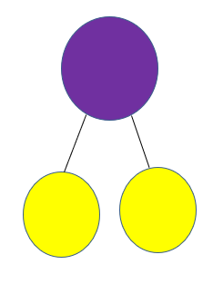
In 2J there are 13 boys and 16 girls. How many children are there altogether?
29
16
13

Slide 24
In 2s there are 17 boys and 16 girls. How many children are there altogether?
T 0
7
1 6
1 3
2 0
3 3
Addition
With
regrouping
How could we put in a
part whole model?
+

Slide 25


Subtraction
Mr Jones had a bag with 35 sweets in it.
He eats 15.
How many does he have left?
Let’s do this together
Notes:
Work through example with parents physically

Slide 26
Subtraction exchanging
Mr Jones had a bag with 32 sweets in it.
He eats 15.
How many does he have left?
Let’s do this together
Notes:
Work through example with parents physically

Slide 27
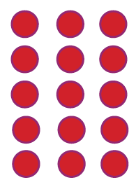
Multiplication
I have 3 bags. There are 5 pennies in each bag. How many pennies do I have altogether?
A teacher might show the children that the first bag has five pennies and draw the five pennies in a line. Then they would explain that the second bag also has five pennies, and draw a second line. They would continue until they had drawn 3 lines of 5 pennies like this:
5 x 3 = 15

Slide 28
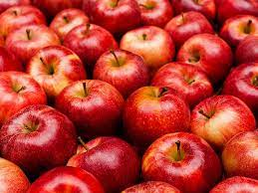
Can you use the resources on your table to solve this problem?
There are 5 apples in each bag.
There are 6 bags.
How many apples are there all together?

Slide 29
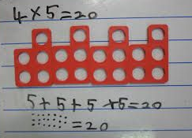
Strategies to support home learning in Number
Multiplication games:
Using concrete objects (including everyday objects) such as pencils, coins, multilink cubes, Numicon tiles or tokens , show your child how times tables are made of groups, e.g. 1 group of 2, 2 groups of 2, 3 groups of 2, etc.
Singing times tables songs (x2,x5 or x10) with modern pop songs
https://www.youtube.com/playlist?list=PLb7Q5jsm9eh_fdDPQmVpyp4XRu-raUbHc

Slide 30
How to help at home

Slide 31
How can you help your child with Maths at home?
Take away their fear.
Reassure and praise whenever possible. Positive mindset…
Let them see you using Maths in your everyday routines – portioning meals between the family, chopping vegetables into halves and quarters etc.
Play with numbers and shapes through games.
Seeing mistakes as an opportunity to learn and using them as a discussion point.
Recognising the importance and value of maths in our everyday lives e.g. managing money and telling the time.

Slide 32
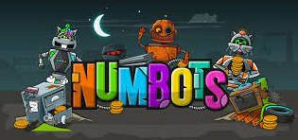
Numbots can be played online on a laptop or you can download it as an app (it’s free!). Passwords and usernames have been given to children.

Slide 33

Times Table Rock Stars
Having a secure understanding of the times tables facts and related division calculations up to 12x12 aids children in their mathematical learning within a wide range of different concepts.
Times Table Rock Stars is an exciting game which helps children to learn and practise their times tables. Through a “little and often” approach, children secure their times table knowledge whilst having fun! We recommend approximately 5 minutes practice a day, 4 or 5 times a week.
You can download the app from the app store or play on the Times Table Rock Stars game on their website.

Slide 34
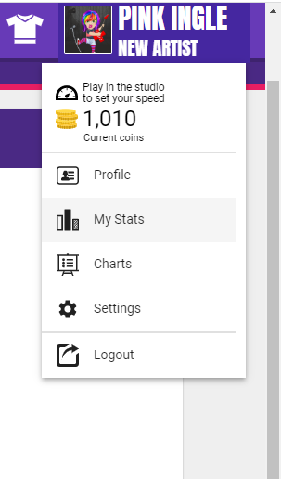
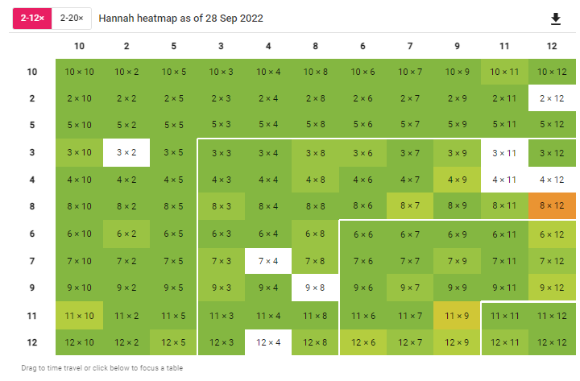
Checking your child’s progress
Checking your child’s progress is easy:
When your child has logged in, select their avatar in the top right hand corner and then select the ‘My Stats’ option.
In the effort tab, you can see how many minutes the children have played.
Under fluency, you can see how quickly your child is able to answer each question and how confident they are with their individual times table knowledge.

Slide 35
A quick guide to everyday Maths opportunities for your child
Practise spotting and recognising numbers in the environment. Add/multiply/subtract/divide door numbers, numbers on car registration plates, road signs and at the shop.
Flicking through the TV guide? Ask your child to calculate the length of their favourite programmes. How long is it until the next programme?
Use food packaging to discuss 2D and 3D shapes. What are the properties of these shapes e.g. how many faces, sides, vertices? Flatten the packaging out to find the net of the 3D shape too.
Measuring up for new furniture? Want to make sure the Christmas tree will fit in your living room? These are really good opportunities to encourage your child to see the value of careful measuring skills in everyday life.
Practise telling the time with your child. Can they read both the digital and analogue clock? Can they readily convert between the two.
Board Games supply endless opportunities for Maths – Snakes and Ladders, Monopoly, Bingo, Connect Four, Battle Ships etc

Slide 36
Strategies to support home learning in Number
Play a mystery game with your child using a feely bag ‘Which multiplication am I?’ e.g pull out 10 cubes and organise into 2 groups. Ask your child to say the number sentence and then write it eg 10 x 2 = 20
Using concrete objects on your table, a feely bag and dice. Without looking in the bag, ask your child to pull out either 2 concrete objects, 5 or 10. Now roll the dice eg your child pulls out 5 cubes and rolls the dice to reveal 3. This becomes 5 x 3. Your child needs to show 5 , 3 times with that object (3 groups of 5).
Notes:
Teachers in Key Stage 1 will teach children how to count in 2s, 5s and 10s and make sure they are very confident in this, before going on to show them how to work out times table problems like this one using arrays.
This is because children need to be able to count up in steps of different numbers before they can use arrays to help them.

Slide 37


Websites to support children’s Maths skills
CBeebies have lots of fun and interactive games and activities to help get our younger children excited about Maths
I See Maths – a useful site with a plethora of ideas for fun games that all the family
Primary Games Arena - It is a free website that encourages children to play online maths games linked to their home learning. It breaks the games down into concepts which is really helpful.
Hit the Button – children love this game as it helps to increase confidence through practising times tables and number bonds.
Maths Zone – this site is jam-packed with fun ways to learn more about maths.
BBC Bitesize – lots of information alongside short videos help to make the learning enjoyable and accessible for all children.

Slide 38


