Slide 1
Parent Phonics Workshop
11th September 2024

Slide 2
What is Phonics?
Phonics is how we teach reading to our children
Phonics teaches the children the link between letters and the sounds that they make.

Slide 3
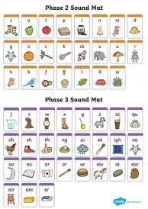
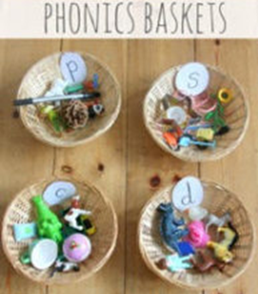
How do we teach phonics at Abbey?
Our school approach is ‘Letters and Sounds’
Across the school all children have daily phonic lessons
Phase 1 to Phase 6
We teach the pure sounds

Slide 4

Correct pronunciation of phonic sounds

Slide 5
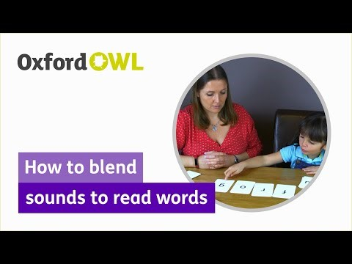
Blending and segmenting
What is blending?
Putting the individual sounds together to make the word.
c-a-t d-o-g b-u-s
s-o-ck f-i-sh
b-oa-t sh-ee-p

Slide 6





Blending and segmenting
What is segmenting?
Breaking down a word into it’s individual sounds.

Slide 7
Tricky words
Some words cannot be ‘sounded out’. We call these the tricky words.
Phase 2: the, to, I, no, go, into
Phase 3: he, she, we, me, be, was, my, you, her, they, all, are
Phase 4: some, one, said, come, do, so, were, when, have, there, out, like, little, what
You will have word lists sent home to practise with your child.

Slide 8
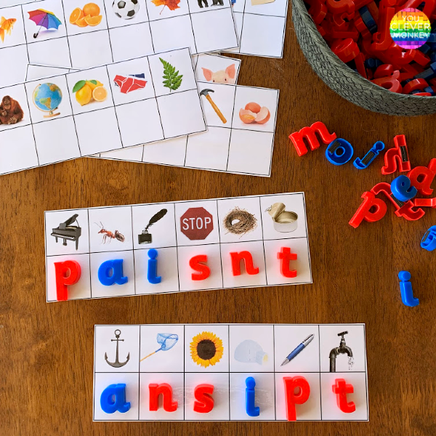
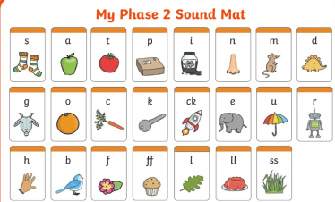
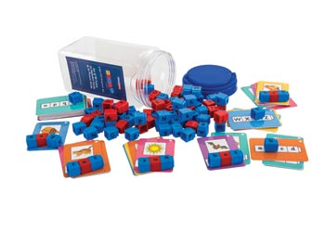
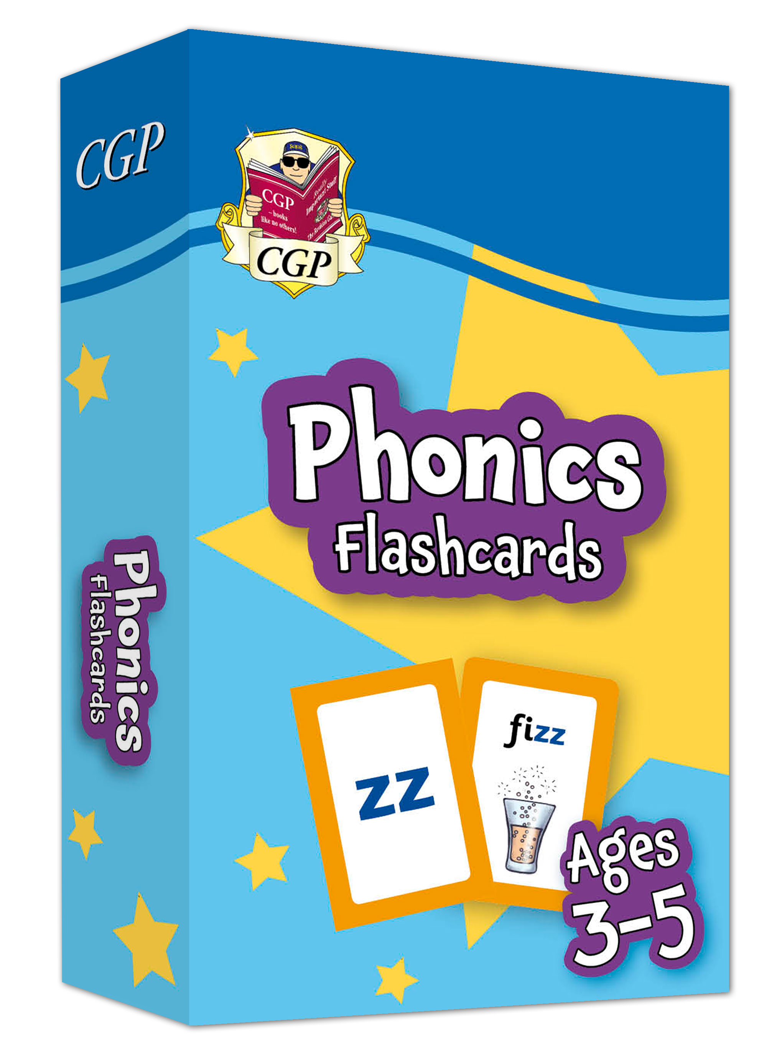
Resources used to teach phonics
Please feel free to take a look at the range of resources and activities that we use to teach your child in Reception.

Slide 9

Ways to help at home
Regular reading of the school reading book - just five minutes every day – little and often
Learn the sounds and their letter names – reading homework sheet and flashcards
Share and listen to stories, value and enjoy reading
Praise, encourage, be patient and watch your child start to read

Slide 10

Read, read
and read
some more…

Slide 11
Useful links
https://www.youtube.com/channel/UC7sW4j8p7k9D_qRRMUsGqyw
Mr Thorne does phonics
https://literacytrust.org.uk/information/what-is-literacy/what-phonics/ National Literacy Trust
https://schoolreadinglist.co.uk/reading-lists-for-ks1-school-pupils/100-best-picture-books-to-read-before-you-are-5-years-old/
Top 100 books to read before turning 5.

Slide 12

Thank you for attending

