Slide 1
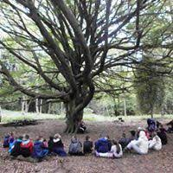
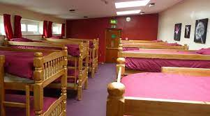


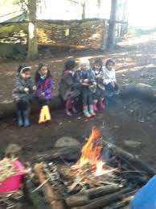
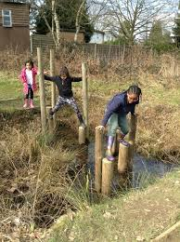
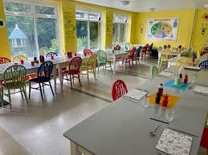

Slide 2
FRANK CHAPMAN 2026
Wednesday 10th June
–Friday12thJune

Slide 3
Staff
Mrs Johnson
Mrs Windmill
Mr Knight
Mrs Yale
Miss Rouse
…as well as all the lovely Frank Chapman staff.

Slide 4
Aims
To have a fun time!
To work as part of a team.
Develop communication skills by listening, explaining and encouraging each other during activities.
Problem solving skills.
Development of Geography and Science skills (orienteering/map reading/map making classification)

Slide 5
Departure and Return
Wednesday 10th June
Arrive at school at normal time.
Children to enter via the main entrance and take their bags into the hall.
Coach is due to depart around 9:30am.
Children should come to school in suitable clothing and will not need to bring any food. (Other than a packed lunch for the first day)
Friday 12th June
Return to school at approximately 2.30pm.
You will receive a text when we are close to school with a more accurate arrival time.
You may collect your child at the normal time of 3:15pm or earlier if you wish.

Slide 6
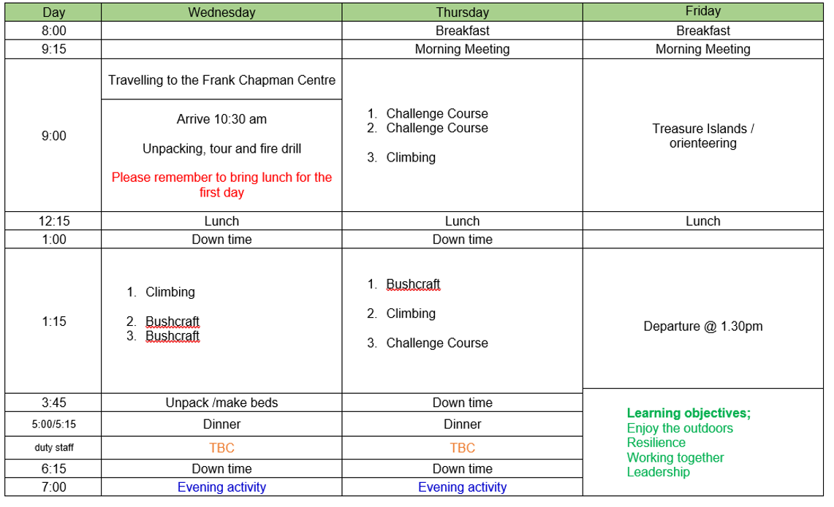

Slide 7
Keeping in Contact
You will receive a text to let you know that the children have arrived safely.
Whilst we are away, you will be kept up to date as much as we can manage, on the fun time that your child is having via the class pages.
Photos and messages will be posted on our school website. However time is limited and the internet connection is not great so please be patient – evenings will be the best time to check for updates. (Go to ‘Children’; ‘Class Pages’ and look for ‘Frank Chapman 2026’)

Slide 8
Medical
If there is any medication that will need to be administered during the stay at Frank Chapman, please ensure that you have completed the relevant paperwork in advance. E.g brown inhaler, creams etc.
This is any medication that is additional to any used in school that we are aware of.
Please complete the relevant paperwork with the office by Wednesday 3rd June.
Please do not leave until the day of departure as the paperwork needs authorisation.

Slide 9
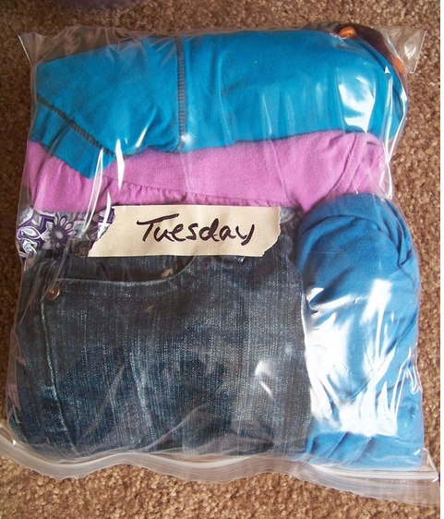
What they will need.
A kit list was issued with your place offer letter.
Please ensure that all items are clearly named and that they are clothes which are suitable for physical, outdoor activity – clothes you don’t mind getting dirty!
Books and a teddy bear are more than welcome!
Top tip for packing! Pack a days worth of clothes in a labelled carrier bag.
£5.00 spending money to be sent to the office in a named envelope if not already done so.

Slide 10
We are encouraging children to bring their own bedding this year to help
them settle in and this is a welcome part of keeping a connection with
home.
If this is not possible the centre will provide them. Please don’t go out
and buy new.
Kit List
Suitcase small enough for your child to carry
Sleepwear ( warm for possible cold nights)
Slippers
Sweater/fleece- fairly thick x2
Trousers x 4
T-shirts x6
Washing Kit and towel for themselves to shower
Outdoor shoes x 1
Wellies
Waterproofs
Coat x 1
Plastic bags ( for dirty clothes x 5)
Duvet cover, pillow case and bed sheet- all single size

Slide 11
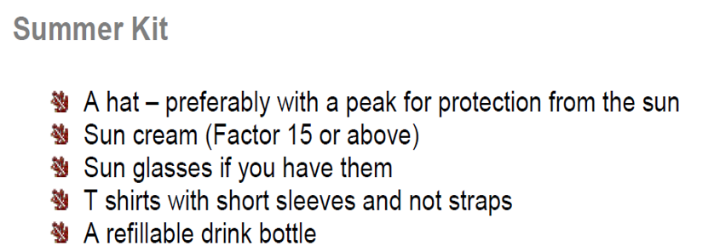

Slide 12
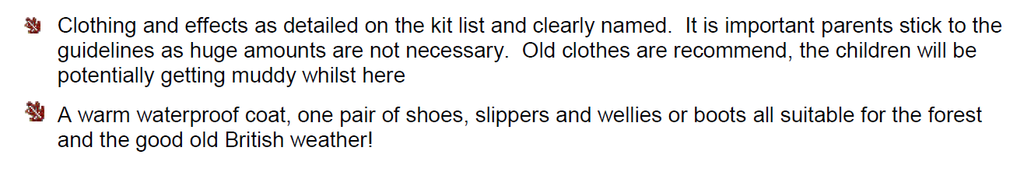
Reminder
No food needed except packed lunch for the first day if you don’t want the school one. No digital devices!

Slide 13
Any questions?

